Slide 1
Chapter 1-1
Fundamentals of Quantitative Design and Analysis

Slide 2
Topics in Chapter 1
1.1 Introduction
1.2 Classes of computers
1.3 Defining computer architecture and What’s the task of computer design?
1.4 Trends in Technology
1.5 Trends in power in Integrated circuits
1.6 Trends in Cost
1.7 Dependability
1.8 Measuring, Reporting and summerizing Perf.
1.9 Quantitative Principles of computer Design
1.10 Putting it altogether

Slide 3
What’s CA?
What’s a CA designer’s task ?

Slide 4
What’s Computer Architecture
Patterson’s talk : “50 years of Computer Architecture”
  https://www.bilibili.com/video/av46710093/
The future of computing- a conversation with John Hennessy
  https://www.bilibili.com/video/av23283946/
Technology
  A key factor in the long run of CPU performance improvement.

Slide 5
iEvolution of computer marketeomputer
Original:
  Big Fishes Eating Little Fishes

Slide 6
1988 Computer Food Chain
iEvolution of computer marketeomputer
* Microprocessor performance improvement: 35% yearly
* Cost advantages of a mass-produced microprocessor
Mainframe
Work-
station
PC
Mini-
supercomputer
Mini-
computer
Supercomputer
Easier success of new architecture:
Virtual elimination of assembly language programming
Creation of standardized vendor-independent OS
Massively Parallel Processors

Slide 7
Evolution of computer market
Mini-
supercomputer
Mini-
computer
Massively Parallel Processors
Embedded system
Mainframe
mobile
phone
Work-
station
PC
Server
Supercomputer
RISC-based computers raised performance bar: RISC replace CISC
In low-end application, power performance: ARM replace x86

Slide 8
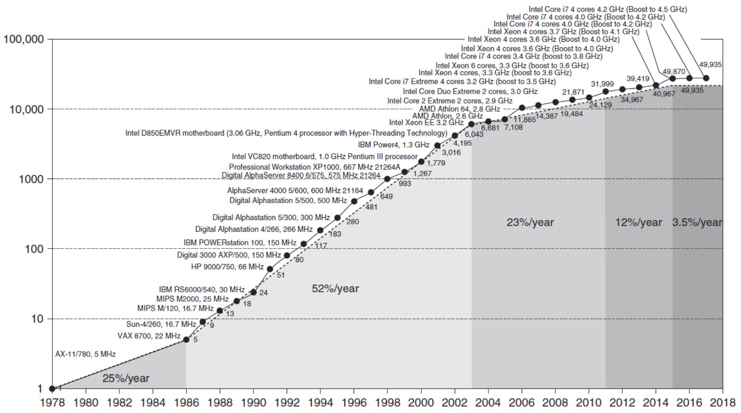
Incredible CPU performance improvement
VAX : 25%/year 1978 to 1986； RISC+x86: 52%/year 1986 to 2002； RISC+x86: 22%/year after 2002

Slide 9
What the figure tell us ?
Performance improvements:
25%: Technological improvements more steady than progress in computer architecture.
  Feature size, clock speed
52%: After RISC emergence, computer design emphasized both architectural innovation and efficient use of technology improvements.
  Computer Architecture plays an important role in performance improvement
  Pipeline, dynamic scheduling, ooo, branch prediction,
  speculation, superscalar, VLIW, prediction instructions, ……

Slide 10
Effect of dramatic growth rate during 20th centrury
  Technology Advances
    CMOS VLSI dominates older technologies (TTL, ECL) in cost AND performance
  Computer architecture advances
    RISC, superscalar, OOO, Speculation, VLIW, RAID, …
  Enhanced the capability of computer users:
    perfmicroprocessor > supercomputer 20 years ago
  New class of computer
    PC、work station→mobile phone, laptops access warehouse containing millions of servers
  Donimance of microprocessor-based computers across the computer design
    Minicomputer→ server , mainframe, supercomputer → collections of microprocessor
  Change software
    Trade performance for productivity c,c++ → java, scala; javaScript, Python
    Change nature of applications: scientific calculation→ speech, image, video

Slide 11
What’s Computer Architecture
Concept Evolution
The attributes of a [computing] system as seen by the programmer, i.e.,
the conceptual structure and functional behavior, as distinct from the organization of the data flows and controls the logic design, and the physical implementation.
  Amdahl, Blaaw, and Brooks, 1964

Slide 12
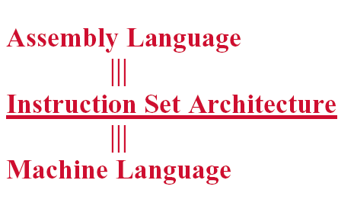
Programmer’s perceptual
Notes:
From the view of language, a computer can be viewed as multiple level virtual machine.
How can we improve the performance ? We explore the parallelisms.

Slide 13
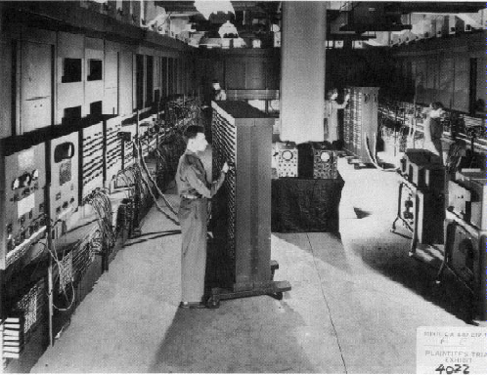
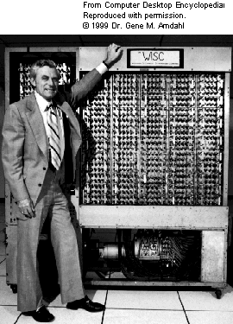
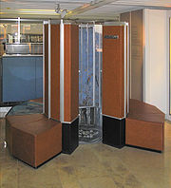
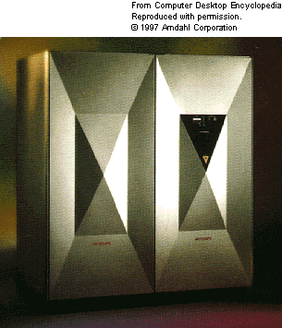
Very different appearance

Slide 14
Very Different ISA
PDP-11
IBM 360
VAX
CRAY
…
LC3
80x86
PowerPC
MIPS
ARM
RISC V

Slide 15
New Concepts ?
Tradeoff
Computer Architecture is the science and art of selecting and interconnecting hardware components to create computers that meet functional, performance, cost and power goals.
It is a blueprint and functional description of requirements and design implementations for the various parts of a computer, focusing largely on the way by which the central processing unit (CPU) performs internally and accesses addresses in memory.

Slide 16
Computer architecture
Computer architecture comprises at least three main subcategories:^{[1]}
Instruction set architecture,
Microarchitecture, also known as Computer organization is a lower level, more concrete and detailed, description of the system that involves how the constituent parts of the system are interconnected and how they interoperate in order to implement the ISA.[
System Design which includes all of the other hardware components within a computing system such as:
    Logic Implementation
    Circuit Implementation
    Physical Implementation

Slide 17
Seven dimensions of ISA
Class of ISA
Memory addressing
Addressing modes
Types and sizes of operands
Operations
Control flow instructions
Encoding an ISA

Slide 18
Computer Applications
Architects need to understand applications’ behavior
  We say we design general purpose processors, but they really focus on specific sets of applications
  Architecture can be tuned to applications
Types of applications today
  Scientific
    Weather prediction, crash analysis, earthquake analysis, medical imaging, imaging of the earth (searching for oil)
  Business
    database, data mining, video
  General purpose
    Microsoft Word, Excel
  Real-time
    automated control systems,
  Others: Games, Mobile，Internet of Things，5G

Slide 19
The Task of Computer Design-2
Determine the important attributes of a new machine to maximize performance while staying with constrains, such as cost, power, availability, etc.
  instruction set architecture design
  functional organization
    High level aspects of computer design, i.e. memory system, bus architecture and internal CPU design.
  logic design ( hardware )
  implementation (hardware )

Slide 20
Incredible CPU performance improvement
VAX : 25%/year 1978 to 1986； RISC+x86: 52%/year 1986 to 2002； RISC+x86: 22%/year after 2002

Slide 21
Why lower down after 2004 ？
Power density was constant for a given area of silicon even as increase the number of transistors
  voltage couldn’t keep dropping and still maintain the dependability
  Single inefficient processor → multiple efficient processors or cores
  ILP → DLP, TLP, RLP( explicitly parallelism）
Combination of
  Transistors no longer etting much better due to Slowing of Moore’s law
  The unchanging power budgets for microprocessors
  Replacement of the single power-hungry processor with several energy-efficient processors
  The limits to multiprocessing to achieve Amdahl’s Law

Slide 22
Challenges of “three walls”
ILP Wall
  diminishing returns on finding more ILP HW (Explicit thread and data parallelism must be exploited)
Memory Wall
  growing disparity of speed between CPU and memory outside the CPU chip. Memory latency would become an overwhelming bottleneck in computer performance.
Power Wall
  the trend of consuming double the power with each doubling of operating frequency

Slide 23
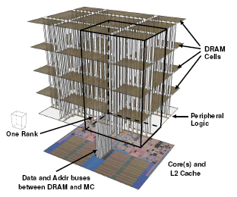
Trends of Computer Architecture
Why?
ILP → TLP(data level parallel)
→ DLP(data level parallel),
Google file system, MapReduce, column-oriented DB
2D memory → 3D stack memory
Performance → Power-aware design

Slide 24
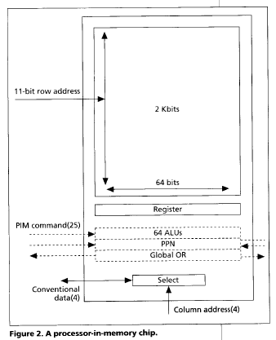
Computational RAM / PIM
Processor in memory (PIM)
  Processing in memory (PIM, sometimes called processor in memory) is the integration of a processor with RAM (random access memory) on a single chip. The result is sometimes
  known as a PIM chip.
1995. 4 IEEE computer
  Processing in memory: the
  Terasys massively Parallel PIM Array.

Slide 25
Memory as an Accelerator
CPU
core
CPU
core
Mini-CPU core
GPU
core
GPU
core
Memory
Video
core
CPU
core
CPU
core
GPU
core
GPU
core
Imaging core
Lower Level Cache
Specialized
Compute capability in memory
Memory controller
Bitwise Operation： In-DRAM copy，zero，and，or，not

Slide 26
Current Trends in Architecture
Cannot continue to leverage Instruction-Level parallelism (ILP)
  Single processor performance improvement ended in 2003
New models for performance:
  Data-level parallelism (DLP)
  Thread-level parallelism (TLP)
  Request-level parallelism (RLP)
These require explicit restructuring of the application

Slide 27
Recent research fields
  Power-aware computer architecture
  Reconfigurable computer architecture
  Multicore, Manycore,
  HPS : P→T→ E-level computer
  PIM： Processor in Memory
  AI processor -----GPU & FPGA
  DSA： Domain Specific Architecture
  Hardware and Software Codesign

Slide 28
Where to explore the parallelism ?
Implicity, compiler and hardware
→ Explicity, programmer
So, YOU, programmers have to know parallelism in hardware, and to explore parallelism when design Algorithm and programming !
Parallelism
Hardware → Hardware and compiler → compiler and programmer
ILP, Loop-level Parallism → TLP, DLP

Slide 29
Something more about Computer Architecture

Slide 30
Fastest computer in China
2011 Tianhe-1A - MPP
2008 Dawning 5000A
  30720 node * AMD Opteron 1.9Ghz QC
  Memory: 122.88TB, Infiniband, 180.6 TeraFLOPS
  OS: Windows HPC 2008
  Rank 10 in top 500 in Nov. 2008
2004 Dawning 4000A
  11 TeraFLOPS
  rank 10 in top 500 in June, 2004
2003 ShenTeng6800
  5.324 TeraFLOPS
2002 ShenTeng1800
  2.04 TeraFLOPS
2000 YinHe IV
  1024个CPU
  1 TeraFLOPS

Slide 31
What are the fastest computers?
  http://top500.org/ June. 2011
1 K computer, SPARC64 VIIIfx 2.0GHz, Tofu interconnect
2 Tianhe-1A - MPP, X5670 2.93Ghz 6C, NVIDIA GPU, FT-1000 8C
3 Jaguar - Cray XT5-HE Opteron 6-core 2.6 GHz
4 Nebulae - Dawning TC3600 Blade, Intel X5650, NVidia Tesla C2050 GPU
5 TSUBAME 2.0 - HP ProLiant SL390s G7 Xeon 6C X5670, Nvidia GPU, Linux/Windows
6 Cielo - Cray XE6 8-core 2.4 GHz
7 Pleiades - SGI Altix ICE 8200EX/8400EX, Xeon HT QC 3.0/Xeon 5570/5670 2.93 Ghz, Infiniband
8 Hopper - Cray XE6 12-core 2.1 GHz
9 Tera-100 - Bull bullx super-node S6010/S6030
10 Roadrunner - BladeCenter QS22/LS21 Cluster, PowerXCell 8i 3.2 Ghz / Opteron DC 1.8 GHz, Voltaire Infiniband

Slide 32
Fastest Supercomputer in the world from http://top500.org/ June. 2013
Rank | Site | System | Cores | Rmax (TFlop/s) | Tpeak (TFlop/s) | Power (kW)
1 | National University of Defense Technology China | Tianhe-2 (MilkyWay-2) - TH-IVB-FEP Cluster, Intel Xeon E5-2692 12C 2.200GHz, TH Express-2, Intel Xeon Phi 31S1P NUDT | 3,120,000 | 33,862.7 | 54,902.4 | 17,808
2 | DOE/SC/Oak Ridge National Laboratory USA | Titan - Cray XK7 , Opteron 6274 16C 2.200GHz, Cray Gemini interconnect, NVIDIA K20x Cray Inc. | 560,640 | 17,590.0 | 27,112.5 | 8,209
3 | DOE/NNSA/LLNL USA | Sequoia - BlueGene/Q, Power BQC 16C 1.60 GHz, Custom IBM | 1,572,864 | 17,173.2 | 20,132.7 | 7,890
4 | RIKEN Advanced Institute for Computational Science (AICS) Japan | K computer, SPARC64 VIIIfx 2.0GHz, Tofu interconnect Fujitsu | 705,024 | 10,510.0 | 11,280.4 | 12,660
5 | DOE/SC/Argonne National Laboratory USA | Mira - BlueGene/Q, Power BQC 16C 1.60GHz, Custom IBM | 786,432 | 8,586.6 | 10,066.3 | 3,945
6 | Texas Advanced Computing Center/Univ. of Texas USA | Stampede - PowerEdge C8220, Xeon E5-2680 8C 2.700GHz, Infiniband FDR, Intel Xeon Phi SE10P Dell | 462,462 | 5,168.1 | 8,520.1 | 4,510
7 | Forschungszentrum Juelich (FZJ) Germany | JUQUEEN - BlueGene/Q, Power BQC 16C 1.600GHz, Custom Interconnect IBM | 458,752 | 5,008.9 | 5,872.0 | 2,301
8 | DOE/NNSA/LLNL USA | Vulcan - BlueGene/Q, Power BQC 16C 1.600GHz, Custom Interconnect IBM | 393,216 | 4,293.3 | 5,033.2 | 1,972
9 | Leibniz Rechenzentrum Germany | SuperMUC - iDataPlex DX360M4, Xeon E5-2680 8C 2.70GHz, Infiniband FDR IBM | 147,456 | 2,897.0 | 3,185.1 | 3,423
10 | National Supercomputing Center in Tianjin China | Tianhe-1A - NUDT YH MPP, Xeon X5670 6C 2.93 GHz, NVIDIA 2050 NUDT | 186,368 | 2,566.0 | 4,701.0 | 4,040

Slide 33
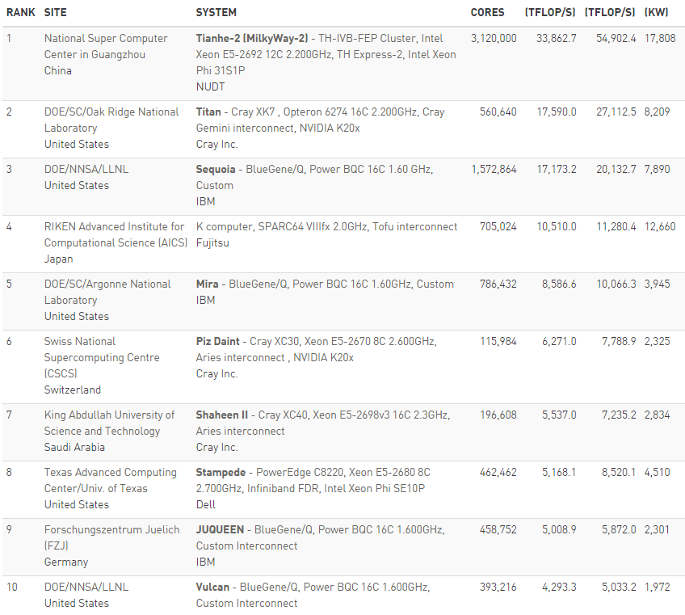
Fastest Supercomputer in the world from http://top500.org/ June，2015

Slide 34
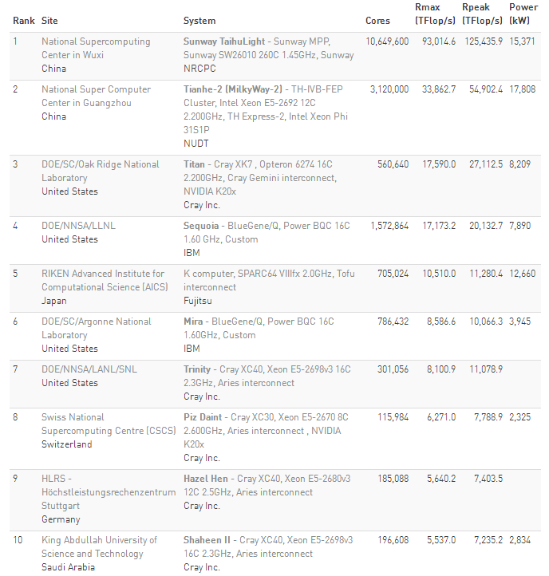
Fastest Supercomputer in the world from http://top500.org/ June. 2016

Slide 35
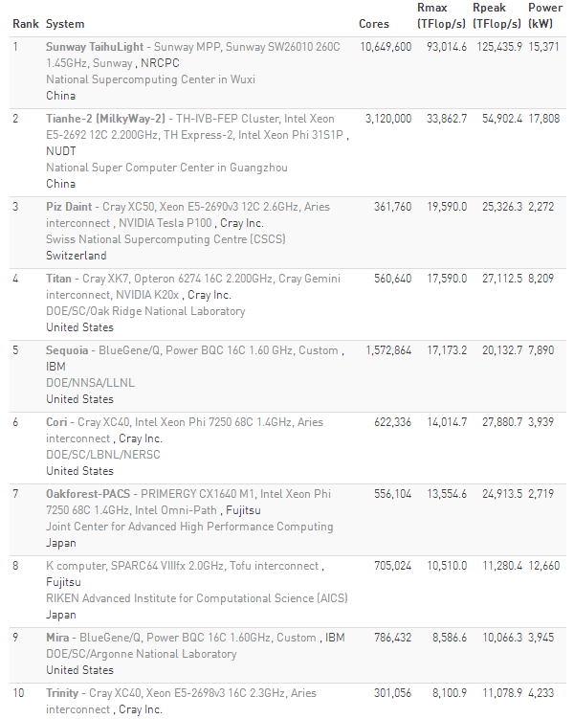
Fastest Supercomputer in the world from http://top500.org/ June. 2017

Slide 36
Overview of TH-2
Items | Configuration
Processors | 32000 Intel Xeon CPUs + 48000 Xeon Phis + 4096 FT CPUs Peak performance is 54.9 Pflops, sustained performance 33.9PFlops
Interconnect | Proprietary high speed interconnection network TH Express-2
Memory | 1.4PB in total
Storage | Global shared parallel storage system, 12.4 PB
Cabinets | 125+13+24+8 = 170 Compute/Communication/Storage/Service Cabinets
Power | 17.8MW
Cooling | Closed Air Cooling System

Slide 37
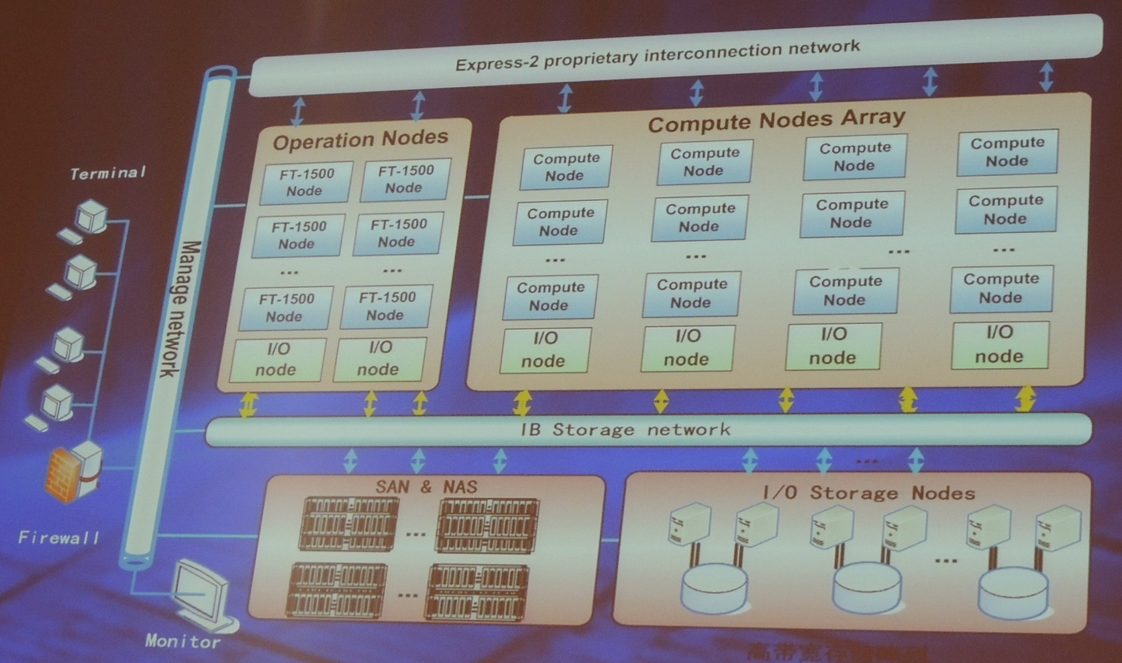
Hardware subsystem of TH-2

Slide 38
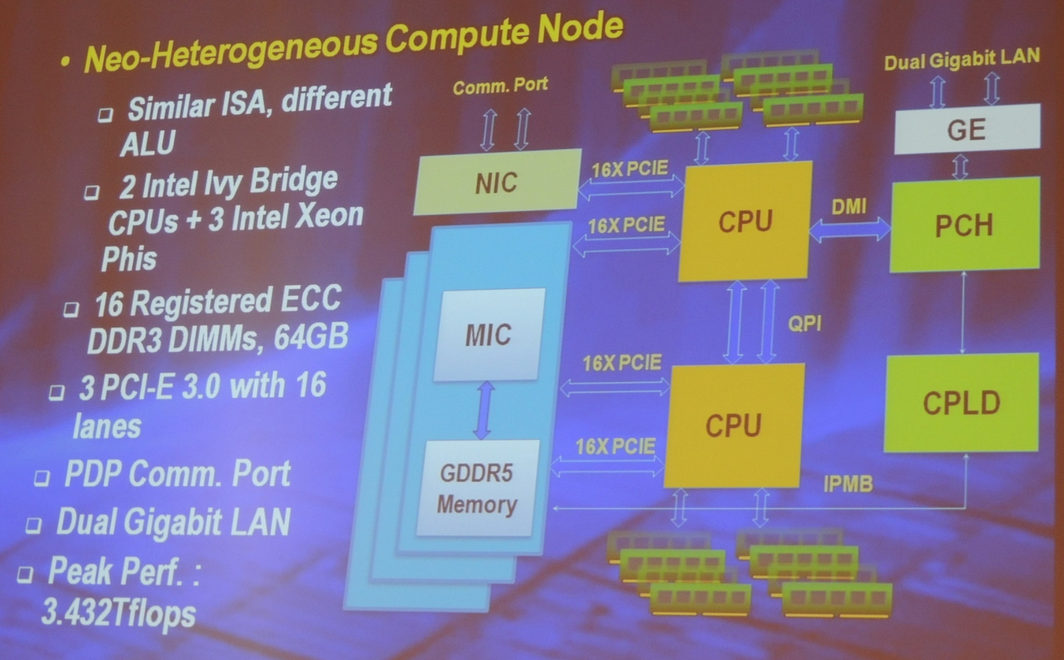
Comuter Node of TH-2

Slide 39
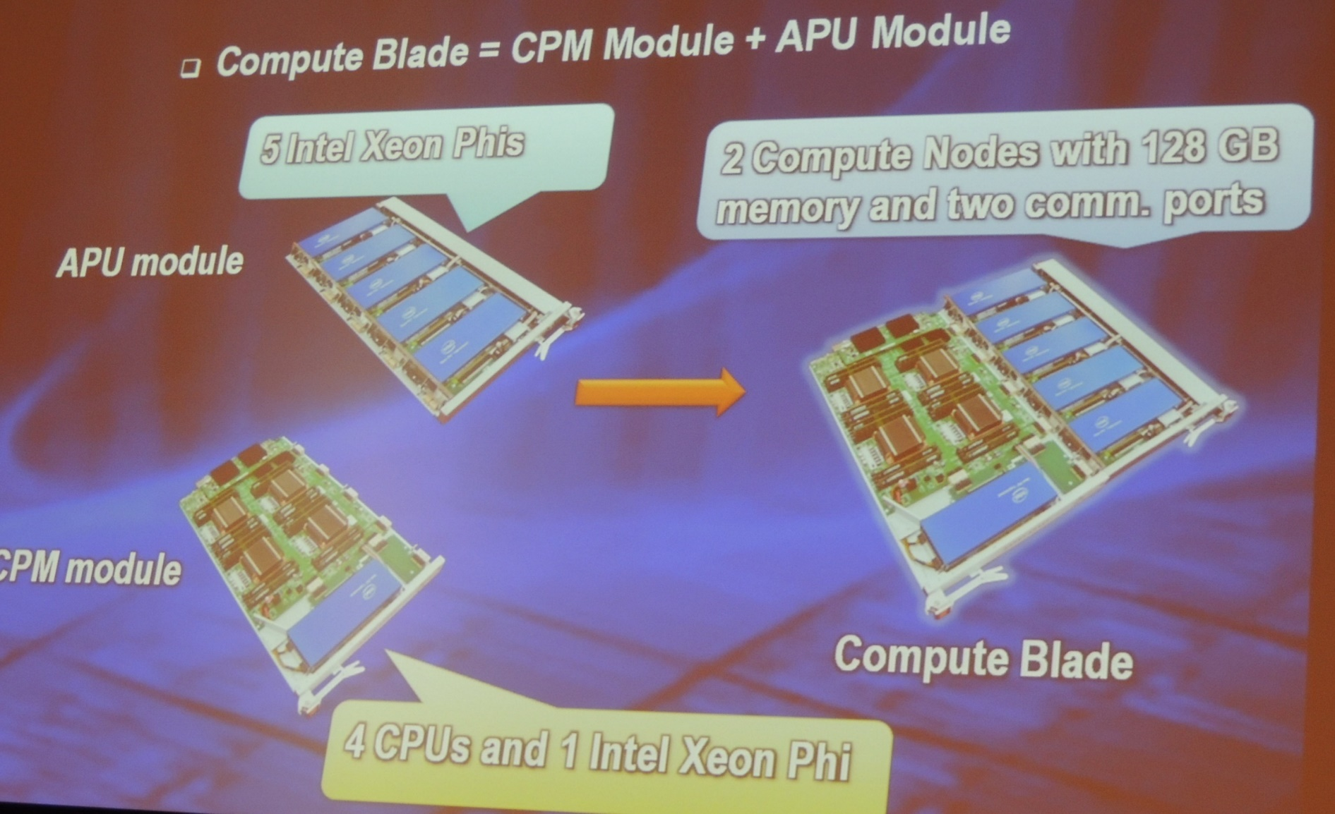
Comuter Node of TH-2

Slide 40
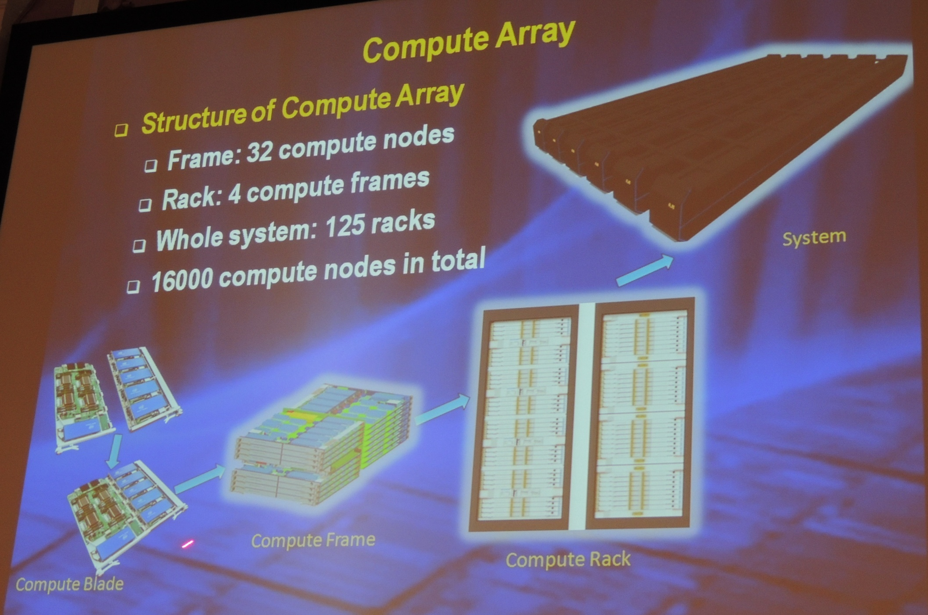
Computer Array of TH-2

Slide 41
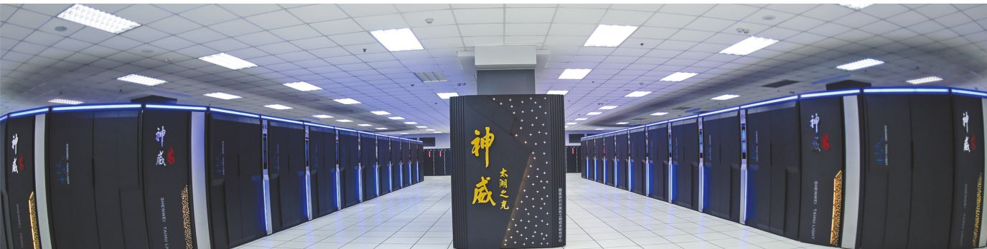
About Taihulight太湖之光
40960 Chinese-designed SW26010 manycore 64-bit RISC processors
X (256 processing cores + 4 auxiliary cores ) per SW26010
= 10,649,600 CPU cores
The processing cores feature 64 KB of scratchpad memory for data (and 16 KB for instructions) and communicate via a network on a chip,
OS: Sunway RaiseOS 2.0.5 on linux with its its own customized implementation of OpenACC2.0

Slide 42
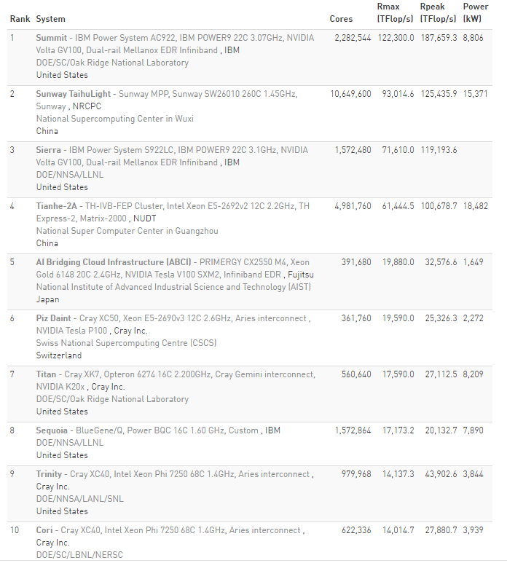
Fastest Supercomputer in the world from http://top500.org/ June. 2018
Summit”的计算能力比神威·太湖之光要快60%，比前美国超级计算机“Titan（泰坦）”要快8倍。

Slide 43
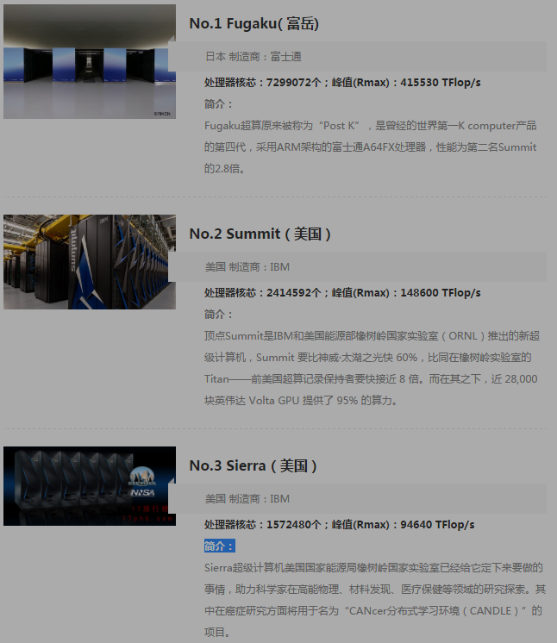
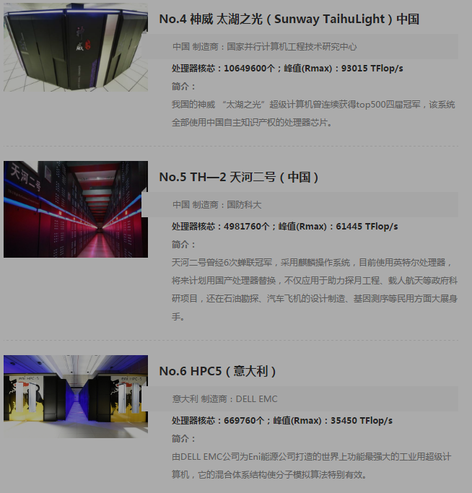
Newest Top 10 June 2020

Slide 44
Chip technology
高纯硅要求99.999999999%,几乎全赖进口，传统霸主依然是德国Wacker和美国Hemlock(美日合资)
硅材料
晶圆
设计与制造
核心设备
封测
台湾的天下，排名世界第一的日月光，还跟着一堆实力不俗的小弟：矽品、力成、南茂、欣邦、京元电子。
大陆的三大封测巨头：长电科技、华天科技、
通富微电
一块300mm直径的晶圆，16nm工艺可以做出100块芯片，10nm工艺可以做出210块芯片，价格可便宜了一半
刻蚀机，中国的状况要好很多，16nm已经量产，7-10nm也在上
离子注入机70%的市场份额是美国应用材料公司
美英特尔、韩三星、日东芝、意法半导体；台湾的：旺宏电子；中国华润微电子等。 但中国高端芯片几乎空白
晶圆代工厂：
台积电，中芯国际
光刻机，荷兰阿斯麦公司(ASML)唯一高端光刻机生产商（12，24，40台/年）
高通、博通、AMD，
中国台湾的联发科，
大陆的华为海思

Slide 45
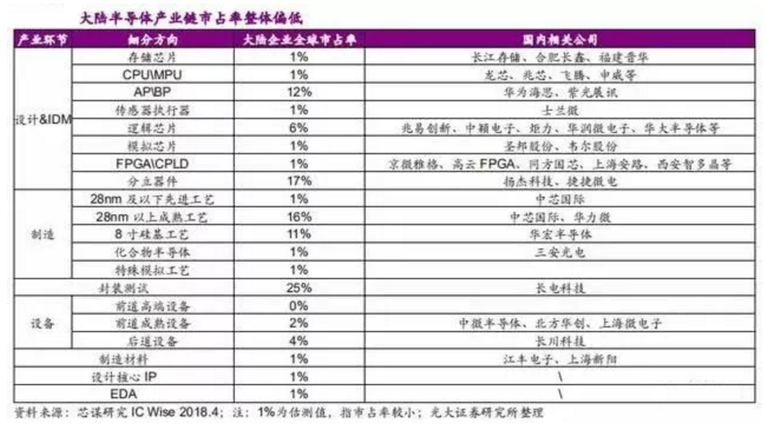
Chip technology
中国芯片的总体水平差不多处在刚刚实现零突破的阶段，虽然市场份额微乎其微，但每个领域都参了一脚，前景还是可期待的。

Slide 46
What are the Big Bananas ?
Eckert-Mauchly Award
  http://www.computer.org/portal/web/awards/eckert
  Administered jointly by ACM and IEEE Computer Society. The award of $5000 is given for contributions to computer and digital systems architecture where the field of computer architecture is considered at present to encompass the combined hardware-software design and analysis of computing and digital systems.

Slide 47
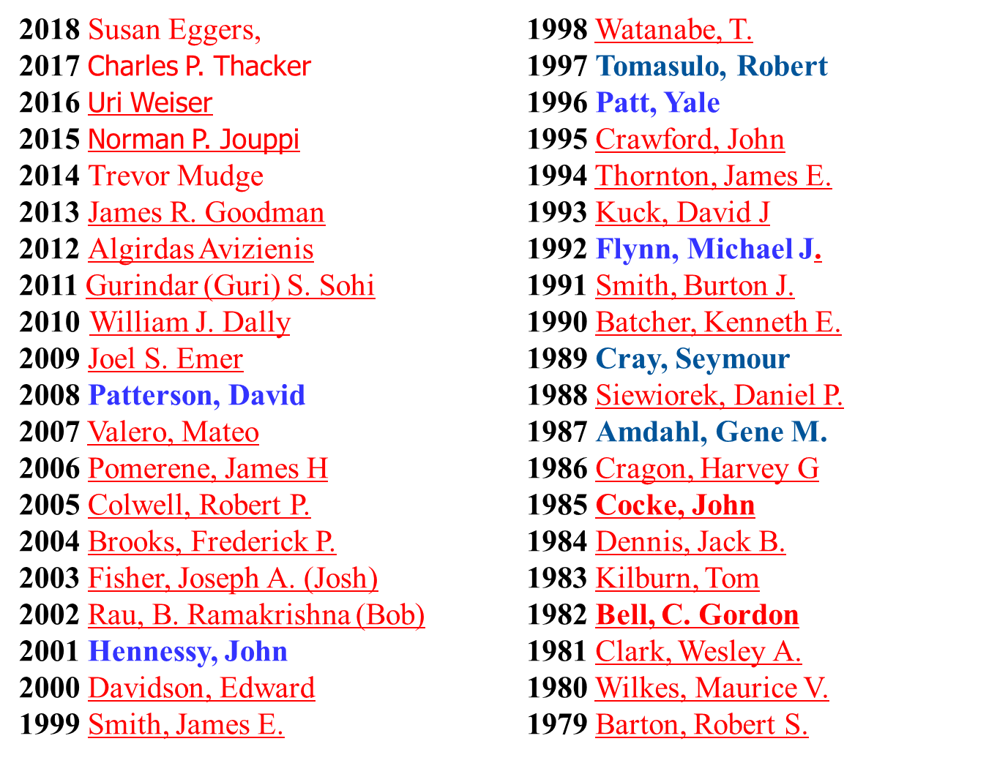
Eckert-Mauchly Award Recipients

Slide 48
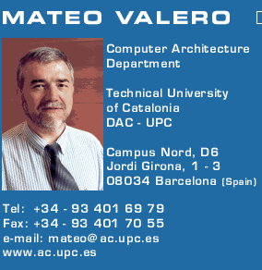
Big Men in Architecture(1)
2007Mateo Valero
  http://personals.ac.upc.edu/mateo/
For important contributions to instruction level parallelism and superscalar processor design.

Slide 49
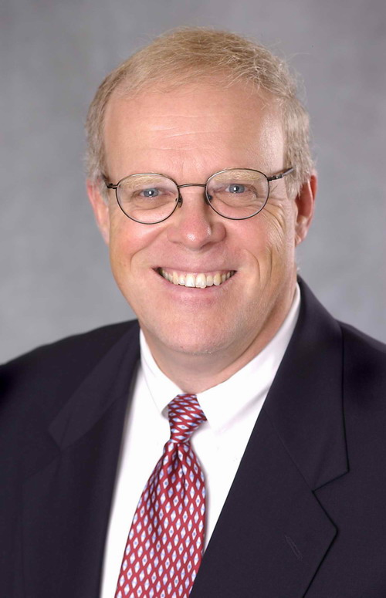
Big Men in Architecture(2)
2001 Hennessy, John
For being the founder and chief architect of the MIPS Computer Systems and contributing to the development of the landmark MIPS R2000 microprocessor.

Slide 50
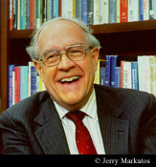
Big Men in Architecture(3)
2004 Eckert-Mauchly Award
"For the definition of computer architecture and contributions to the concept of computer families and to the principles of instruction set design; for seminal contributions in instruction sequencing, including interrupt systems and execute instructions; and for contributions to the IBM 360 instruction set architecture."
Frederick P. Brooks
http://www.cs.unc.edu/~brooks/
1999 ACM Turing Award
landmark contributions to computer architecture, operating systems, and software engineering."

Slide 51
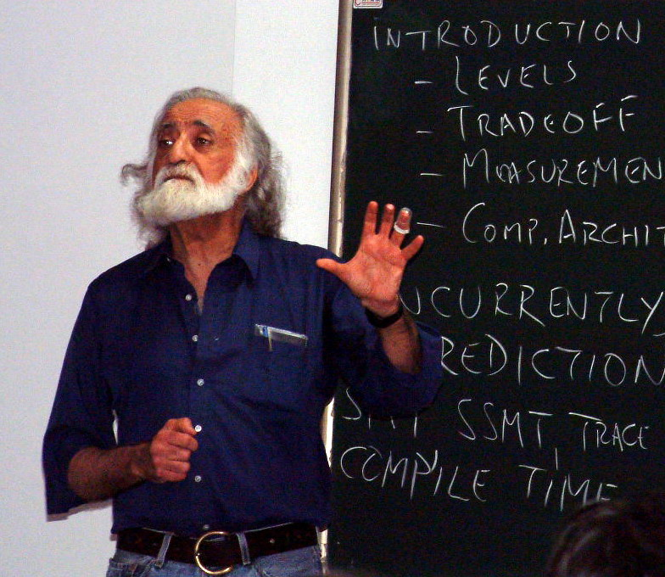
Big Men in Architecture(5)
1996 Yale Patt
For important contributions to instruction level parallelism and superscalar processor design.
Introduction to computing systems
（2013-2017, 2019）

Slide 52
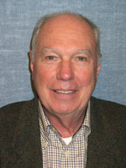
Big Men in Architecture(6)
1992 Michael J. Flynn
http://www.cpe.calpoly.edu/IAB/flynn.html
For his important and seminal contributions to processor organization and classification, computer arithmetic and performance evaluation.

Slide 53
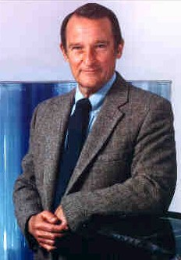
Big Men in Architecture(7)
1989 Cray, Seymour
For a career of achievements that have advanced supercomputing design.

Slide 54
Big Men in Architecture(8)
1987 Amdahl, Gene M.
For outstanding innovations in computer architecture, including pipelining, instruction look-ahead, and cache memory.
In 1975, Dr. Amdahl stands beside the Wisconsin Integrally Synchronized Computer (WISC), which he designed in 1950. It was built in 1952. (Image courtesy of Dr. Gene M. Amdahl.)

Slide 55
Top conferences and Journals
Top conference:
  ISCA
  MICRO,
  …
Top journals:
  IEEE Tran. on Computers IF 3.131
  ACM Tran. on Computer Systems IF 1.917
  IEEE Tran. on Parallel and Distributed Systems. IF 3.402

Slide 56
What’s a CA designer’s task ?

Slide 57
Computer Design Engineering life cycle
Evaluating Existing
Systems for Bottleneck(app.B)
Benchmarks(1.8)
User requirement
Analysis(1.2)
Technology Trend 1.4
Power Trend 1,5
Cost Trend 1.6
Dependability 1,7
Quantitative Principles
1.9
Implement Next
Generation System
Simulate New
Designs and
Organizations
Workloads
Evaluating for energy-performance cost (1.8)
Notes:
Requirement Analysis:
Market analysis: who you will sell 4-1.2
desktop, server, embedded system, HPC
Different markets has different driven motivations.
When design a desktop, it aims to obtain best price-performance.
For the servers, dependability is critical, then the scalability, and throughput.
For the embedded computer systems, price is a key factor, while real-time performance is important . And power efficiency and memory size is always under consideration.
2. Functional requirement: 4-1.3
3. Performance requirement:
4. Power
5. Unfuntional requirements: availability, dependibility 1.7
7. Cost/price

Slide 58
Topics in Chapter 1
1.1 Introduction
1.2 Classes of computers
1.3 Defining computer architecture and What’s the task of computer design?
1.4 Trends in Technology
1.5 Trends in power in Integrated circuits
1.6 Trends in Cost
1.7 Dependability
1.8 Measuring, Reporting and summerizing Perf.
1.9 Quantitative Principles of computer Design
1.10 Putting it altogether

Slide 59
Summary: Task of computer design
Considerations:
  functional and non functional requirements
  implementation complexity
    Complex designs take longer to complete
    Complex designs must provide higher performance to be competitive
  Technology trends
    Not only what's available today, but also what will be available when the system is ready to ship. (more on this later)
  Trends in Power in IC
  Trends in cost
Arguments
  Evaluate Existing Systems for Bottlenecks
Quantitative Principles

Slide 60
Reading Assignments
Chapter 1， Chapter 2.
Homework1 for chapter 1 will be loaded on website

Slide 61
End !
Thank you !

